Slide 1
Management and Outcomes of Congenital Anomalies in Low-, Middle- and High-Income Countries: A Multi-centre, International, Prospective Cohort Study
Global PaedSurg Research Collaboration
Notes:
Good day.
Thank you for this opportunity to present our forthcoming multi-centre, international, prospective cohort study on the management and outcomes of congenital anomalies in low-, middle-, and high-income countries.

Slide 2
Congenital Anomalies Globally
GBD Study 2015
2015:
434,000 deaths from congenital anomalies in < 5-yr olds
420,000 (97%) deaths were in low and middle-income countries
14,000 (3%) in high-income countries
Notes:
So why is it important to focus on congenital anomalies?
In 2015 the Global Burden of Disease Study reported that congenital anomalies have risen to become the 5th leading cause of death in under 5-year olds globally. In real terms, this equates to almost half a million deaths/ year. 97% of those deaths are in low and middle income countries.

Slide 3
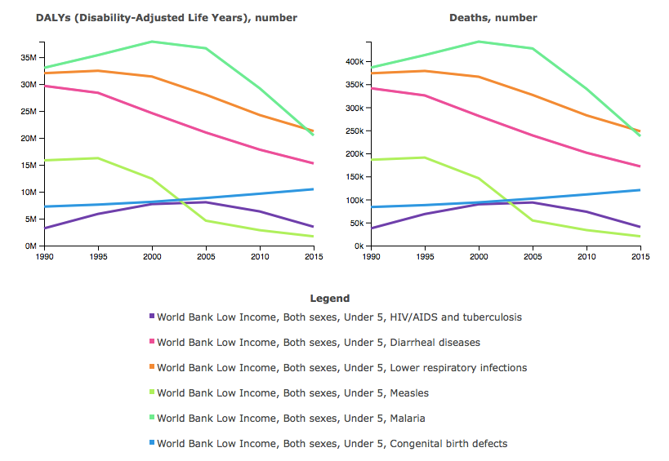
Congenital Anomalies in LICs
The change in aetiology of Disability-Adjusted Life Years (DALYs) & deaths in children <5-years of age in low income countries from 1990 to 2015
Notes:
Over the last 25-years there has been a significant reduction in childhood mortality globally primarily due to a focus on the prevention and management of infectious diseases. You can see on this graph the reduction of deaths and disability from malaria, lower respiratory tract infections, diarrhoeal disease, HIV/AIDS and TB and measles over the last quarter century in under 5-year olds. However, there has been very little focus on improving surgical care for children and you can see that the amount of deaths and disability from congenital anomalies, which typically require a surgical intervention, has continued to rise and without intervention will soon coverage with diarrhoeal diseases as a leading cause of death.

Slide 4
The change in aetiology of deaths in children <5-years of age in low-, middle- and high-Socio-Demographic Index (SDI) countries from 1990 to 2016
Notes:
These graphs show the aetiology of <5 deaths in low, middle and high socio-demiographic index (SDI) regions.
Deaths from congenital anomalies are increasing in low SDI regions. They are declining in middle SDI regions, but less so than other infectious causes of death and hence have risen to become a leading cause of death. Congenital anomalies are a leading cause of death in high SDI regions.
Sustainable development goal 3.2 states that no neonate or child < 5 should die of a preventable cause by 2030. There clearly needs to be a shift in the global health agenda towards provision of surgical care for neonates and children to achieve this. It’s estimated that two thirds of the deaths and disability from congenital anomalies can be averted through surgical care.

Slide 5
Example: Congenital Diaphragmatic Hernia
Dearth of literature from LMICs
14 studies identified: 13 from MICs, 1 from LICs
Mostly single institution, retrospective, small-series
Population studied varies widely
Notes:
One of the main problems we face at present is the dearth of research on congenital anomalies from low and middle income countries.
Here I use congenital diaphragmatic hernia as an example.
We could identify just 14 studies on this condition from low and middle incomes countries (13 from MICs and 1 from a LIC). Yet hundreds of studies have been published on this condition from high-income countries. The LMIC studies that have been published are mostly single institution, small series, retrospective studies with a varied population.
For example, there are two studies from Nigeria on CDH – when inborn patients are included the survival is just 0-40%. However, in the study with just outborn patients who have survived to presentation, the majority survive.

Slide 6
Registries
International Clearinghouse for Birth Defects
Notes:
International registries for congenital anomalies do exist such as the International Clearinghouse for Birth Defects.
However, at present Africa is not included and there is limited global coverage.
Congenital anomaly registries tend to focus on epidemiology and prevention rather than management and outcomes. Prevention is important, but at the moment we don’t know what causes many congenital anomalies and hence we cannot prevent them. Hence, research on management and improving outcomes is vital.

Slide 7
Aim
To undertake a multi-centre, international, prospective cohort study of congenital anomalies across the globe comparing outcomes in low-, middle-, and high-income countries.
Notes:
Hence, we plan to undertake a multi-centre, international, prospective cohort study of the management and outcomes of congenital anomalies in low-, middle- and high-income countries.

Slide 8
Methodology
Prospective data collection on seven congenital anomalies:
1) Gastroschisis
2) Anorectal malformation
3) Oesophageal atresia +/- tracheoesophageal fistula
4) Congenital diaphragmatic hernia
5) Intestinal atresia
6) Exomphalos
7) Hirschsprung’s disease
Over a minimum 1-month period of collaborators choice between Oct 2018 – April 2019, with 30-day post-op follow-up.
Notes:
Prospective data will be collected on the seven congenital anomalies as listed here.
Data will be collected for a minimum of a 1-month period of collaborators choice between October 2018 and April 2019 with a 30-day follow-up period.

Slide 9
Why these conditions?
Selection of the commonest congenital anomalies
All require emergency neonatal surgical care soon after birth
Particularly high neonatal mortality rate (>50% LMICs) in congenital anomalies involving the gastrointestinal tract
Require a similar package of neonatal surgical care
Managed by the same team
Particularly understudied group of conditions

Slide 10
Patient Inclusion/ Exclusion Criteria
Inclusion:
Any neonate, infant or child under the age of 16-years
Presenting for the FIRST time with their congenital anomaly
No previous surgery for the congenital anomaly
More than one congenital anomaly can be included in the same patient
Patients receiving palliative or no care MUST be included
Exclusion:
Patients who have previously received surgical care for their congenital anomaly

Slide 11
Methodology
Data collection: patient demographics, diagnosis, clinical status, interventions and outcomes
Notes:
Data will be collected on the variables shown here – approximately 35 data points per patient in total.
Data will be collected on the user friendly, free-of-charge, online data collection tool, REDCap.
All patient data will be anonymous. REDCap is a secure database that has been used for almost half a million projects globally to date.

Slide 12
Methodology
Primary outcome: all-cause in-hospital mortality
Secondary outcomes: post-operative complications
condition specific outcome variables
Institutional data on the resources available for neonatal surgery
Local study approval will be required at all participating centres
Data analysis: Chi-squared analysis and multi-level multivariate logistic regression analysis
Notes:
The primary outcome will be all-cause, in-hospital mortality.
Secondary outcomes will include post-operative complications and condition specific variables.
Collaborators will be asked to complete a brief survey on the resources available at their institution for neonatal surgery.
Collaborators will require local study approval for participation. The full protocol and study approval from King’s College London will be provided to collaborators to assist this process locally.
Outcomes from low, middle and high-income countries will be compared using Chi-squared analysis.
Multi-level multivariate logistic regression analysis will be used to identify factors affecting outcome with adjustment for confounders. P<0.05 will be deemed significant.
No individual collaborator, institution or country will be independently identifiable in the results. Following publication of the main study, all collaborators can request access to the full dataset (with contributing centres and countries anonymised) or their country-dataset to undertake a sub-analysis if all collaborators from that region agree. Collaborators will have full access to their own dataset at all times.

Slide 13
Data Validation
Patient data:
10% of centres will be selected at random for patient data validation
Independent collaborator to collect selection of the data again
Validation data will be cross-matched with original data for accuracy
Institutional data:
Survey to be independently completed by two collaborators (study lead and one other).
The level of agreement between the two surveys will be analysed

Slide 14
Global PaedSurg Research Collaboration
Notes:
Collaborators will be invited to participate from a wide range of organisations. Any healthcare professional who is involved in the care of infants presenting primarily with congenital anomalies can participate in the study i.e surgeons, anaesthetists, neonatologists, paediatricians, trainees, medical students and nurses. There can be up to 3 collaborators per institution per month of data collection. Hence, there can be more than one team of 3 collaborators collecting data over a different time point between Oct 2018 – April 2019.

Slide 15
Global PaedSurg Research Collaboration
Over 1200 collaborators from 110 countries

Slide 16
Collaborator & Hospital Inclusion Criteria
Any healthcare professional/ hospital caring for one or more of the patients to be included in the study
Juniors require permission from the senior surgeon or physician in the team who oversees patient care
Senior healthcare professional should be a member of the team and hold responsibility for the data collection process, accuracy and completeness

Slide 17
Team Structure
3 collaborators per team per month of data collection
One team for up to 7-months or multiple teams over 1-month each
Data collection will start on the 1st day of the month and end on the last. Each patient will have the month in which their data was collected recorded.
Minimum duration of data collection = 1 month

Slide 18
Notes:
This will be included on a ‘Global PaedSurg Study: Record Sheet’, which all study teams are asked to complete.

Slide 19
Notes:
This is also part of the ‘Global PaedSurg Study: Record Sheet’.

Slide 20
All collaborators as PubMed Citable co-authors
Notes:
All collaborators will be included as PubMed Citable co-authors.

Slide 21
Benefits to Collaborators
Participation in a high impact international research study.
Co-authorship on all international presentations and publications
Opportunity to present the study locally, nationally, internationally.
Development of skills including applying for local study approval, patient identification, protocol application, data collection, and use of REDCap for data upload and analysis.
Following the study, the opportunity to participate in online training to develop and undertake your own project using REDCap.
Optional research training fellowship alongside the main study.
Opportunity for ongoing collaborative research and interventional studies aimed at improving outcomes.
Notes:
The study will be used to create opportunities for collaborators. Hence, collaborators can request to present the study (initially the concept and later the results) at national, regional and international conferences. This often provides collaborators with the opportunity to apply for funding through the conference organisation to attend and present. Participation in the study is a great opportunity for collaborators, particularly trainees, to expand their knowledge and experience with undertaking research and participating in a global study. REDCap training will be organised for any collaborators wishing to set up their own study using the software after the study. An optional research training fellowship will be offered to collaborators wishing to undertake their own local research study alongside the main study under the guidance of monthly research webinars and an academic mentor. We hope that this study will lead to the creation of a research collaboration with the potential for future collaborative work and interventional studies aimed at imporving outcomes. An example is the multi-centre interventional study aimed at imporving survival in neonates born with gastroschisis across sub-Saharan Africa following the PaedSurg Africa mutli-centre prospective cohort study last year.

Slide 22
Benefits to Patients
Development of large population prospective data on congenital anomalies in order to advocate for enhanced neonatal surgical services at a national and international level. Such data is vital to inform advocacy efforts and global health prioritisation.
Identification of factors affecting outcomes in low-, middle- and high-income countries, which can be modified to improve patient care.
The opportunity for centres across the world to learn from each other to improve patient care and outcomes.

Slide 23
Outcomes
First large-series, geographically comprehensive multi-centre prospective cohort study of congenital anomalies across the globe
Identify factors affecting outcomes
Enhance research capacity amongst collaborators
Form a global paediatric surgical research collaboration for future research and intervention studies aimed at improving outcomes
Notes:
This aims to be the first large-series, geographically comprehensive prospective cohort study of congenital anomalies, including CDH, across the globe comparing outcomes in low, middle and high-income countries. This can be used to advocate for much needed resources for neonatal surgical care in LMICs and to help put congenital anomalies on the global health agenda.
We’ll aim to identify factors affecting outcomes, which can be modified to improve care. It provides the opportunity for centres across the world to learn from each other.
Participation in the research will help to build research capacity amongst collaborators – which will help to combat the huge disparity in research outputs between the global north and global south at present.
And creation of the Global PaedSurg Research Collaboration will form a platform for ongoing research and interventional studies aimed at improving outcomes in the future.

Slide 24
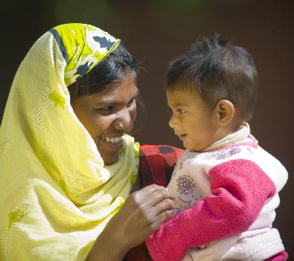
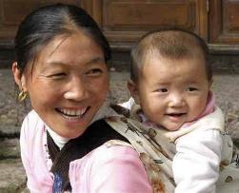
Thank you for listening, any questions?
Naomi Wright: paedsurg.research@gmail.com
@PaedsSurgeon @GlobalPaedSurg #GlobalPaedSurg
www.globalpaedsurg.com
Notes:
If you have any questions please contact your local Country Lead or Dr Naomi Wright (Principal Investigator based at King’s College London, UK). For updates please follow us on Twitter or Facebook. More information can also be found on our website.

