Slide 1
Preparing an abstract for submission at a conference for presentation
Samir K. Gadepalli, MSc, MD, MBA
Assistant Professor, Pediatric Surgery and Surgical Critical Care
University of Michigan
Ann Arbor, MI, USA

Slide 2
Who am I?
Training
General Surgery
Surgical Critical Care
Pediatric Surgery
MBA in Health Care Administration
MSc in Health and Health Care Research
Current Practice
Pediatric Surgery
Surgical Intensivist
Health Services Researcher
I’ve been REJECTED a TON!!!

Slide 3
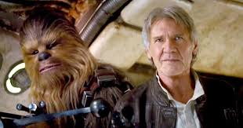
Preparing an abstract
Know the audience; APSA, BAPS, PAPS, CAPS, IPEG
Follow the guidelines; submitted elsewhere? need a manuscript?
Anatomy of an abstract
Background/Purpose (Why?)
Methods (How?)
Results (What?)
Conclusions (So what?)
Trailer for the movie

Slide 4
Background
1-3 lines
First sentence
What we know
Main character
Right altitude
Second sentence (sometimes included in first or third for space)
Problem you want to solve
Third sentence
How your solutions will solve problem
Hypothesis of research

Slide 5
Example

Slide 6
Methods
Length varies
Detail matters
Key components
IRB
Population/Data source
Definitions
Approach
Stats used
Demographics, intervention, outcomes, stats
Be careful not to confuse results/methods

Slide 7
Example

Slide 8
Results
This and the methods are what I use to decide if I accept an abstract
Start HERE – does the whole story make sense
Do I want to hear more about this project?
Be organized
Use your tables/figures wisely
Most important findings
Interpret but don’t judge
Complementary with methods
Are decimal points necessary? How many?

Slide 9
Results (2)
A good results section will get your abstract accepted
Not because of the findings but on how it’s presented
Typically I do it in 3-4 levels
Population studied: Demographics – mean versus median
Comparison of groups: p-values, confidence intervals important
Outcomes: make sure to appropriately adjust for regression (present what was used for adjustment in methods)
Most important finding: Table/Figure
Is it tweetable?
The reader should get to the conclusion before reading it!!

Slide 10
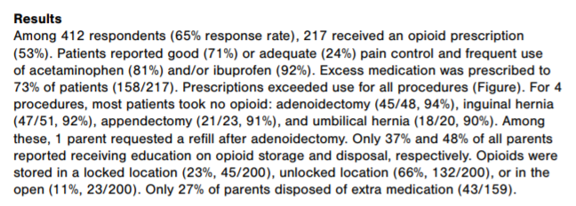
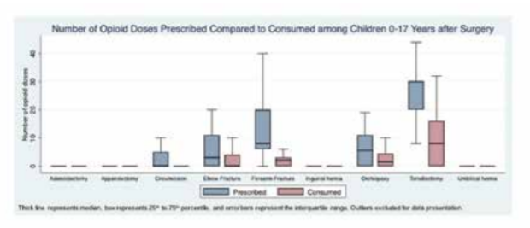
Example

Slide 11
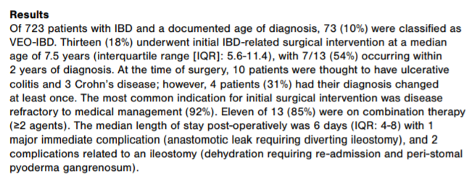
Example 2

Slide 12
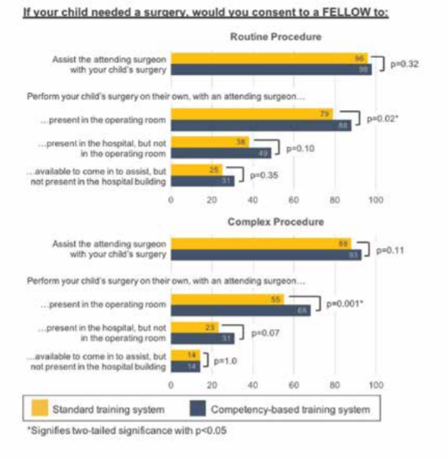
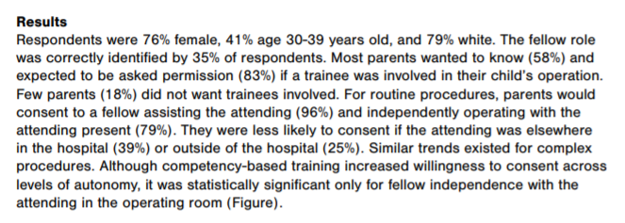
Example 3

Slide 13
Conclusion
Last thing I write but first thing I think about
Just by looking at figures/tables, you should be able to tell the takeaways
What are the implications/main findings
Why should this be the abstract chosen – “first one”, “largest”, “unexpected findings”, “important problem”
Keep it simple. Make it easy to read.
And Memorable!

Slide 14
Example

Slide 15
Good luck!! Thank you!!
Questions??

