Slide 1
Global PaedSurg Research Training Fellowship
Session 10
Journal Selection and Submitting for Publication Nathan Novotny, MD, FACS, FAAP - 27/9/19

Slide 2
Disclosures
Ad hoc peer reviewer for J Pediatr Surg, J Surg Res, J Laparoendosc Adv Surg Tech, Eur J Pediatr Surg, Videoscopy
Publications committee for APSA
Editorial board member of J Surg Res 2008-17
I’m American and I am guilty of most of the biases held by my fellow Americans
But I’m working on it...

Slide 3
Objectives
Understand the reason for publishing scientific works
Accurately assess your manuscript and which journal is the
best fit
Identify characteristics of journals with scientific value
Identify characteristics of journals that simply want your $$
Understand where to find and how to properly format your
publication prior to submission

Slide 4
Background
Everyone (nearly) wants to publish
Everyone wants to make an impact
Everyone wants to provide the best care to his/her patients

Slide 5
Background
Everyone wants to provide the best care to his/her patients
By making an impact
By publishing

Slide 6
BMJ says...
Make sure your paper fits within the scope of the journal
Assess the credentials of the journal or publisher
Browse the content they publish for quality and relevance to your field
Check the quality of their website
Check what tools and services they offer to authors
Submit your research to one journal only, but check if they offer transfers to other journals
Follow the instructions for authors carefully
https://authors.bmj.com/before-you-submit/how-to-choose-a-journal/

Slide 7
Make sure your paper fits within the scope of the journal
Somewhat self-explanatory
And yet don’t think only ped surgical journals
Other options include:
Adult GNS
Peds
Peds subspecialties (EM, GI, Crit Care, ID, etc)
Global Health
Public Health

Slide 8
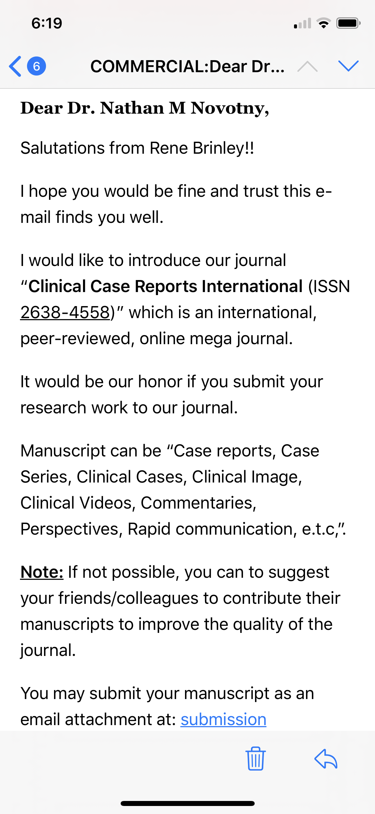
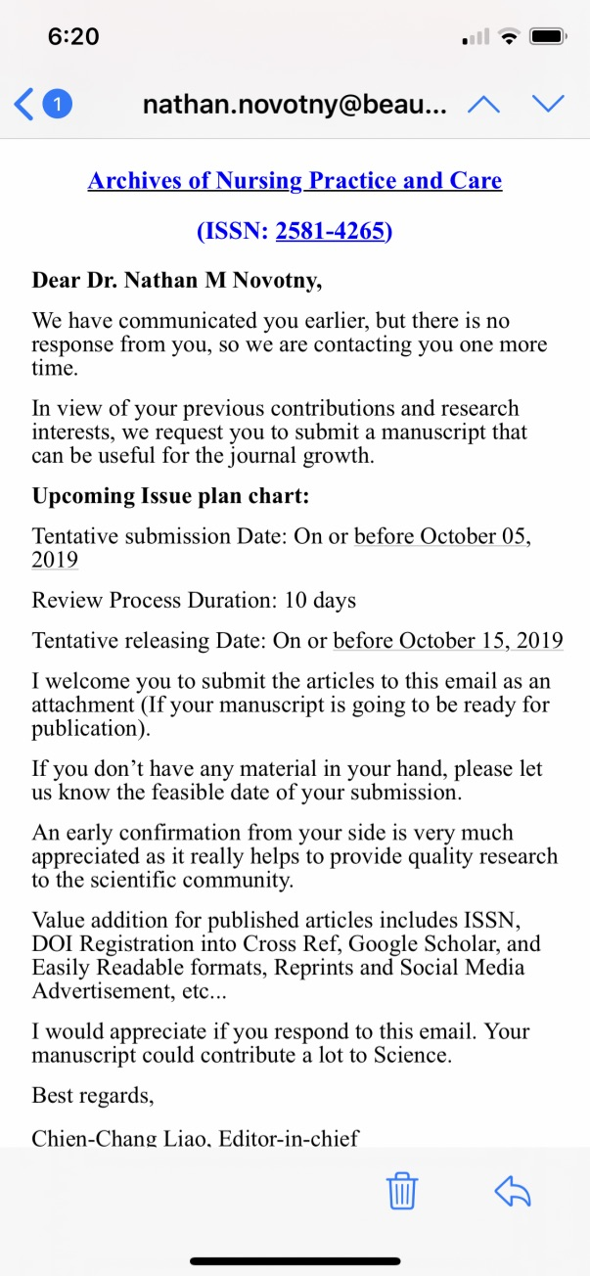
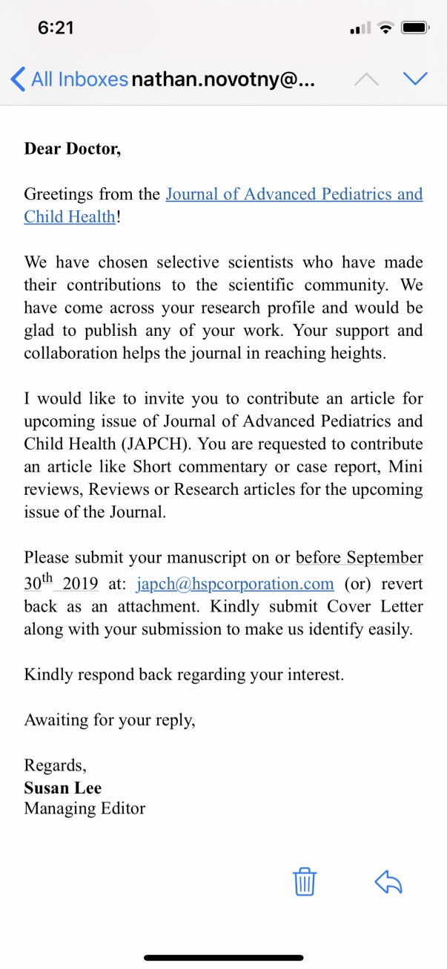
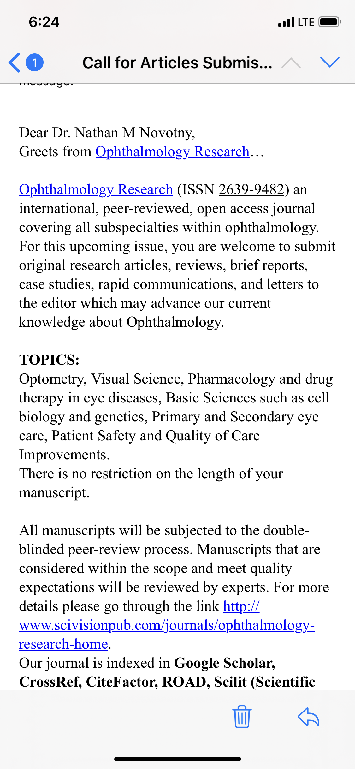
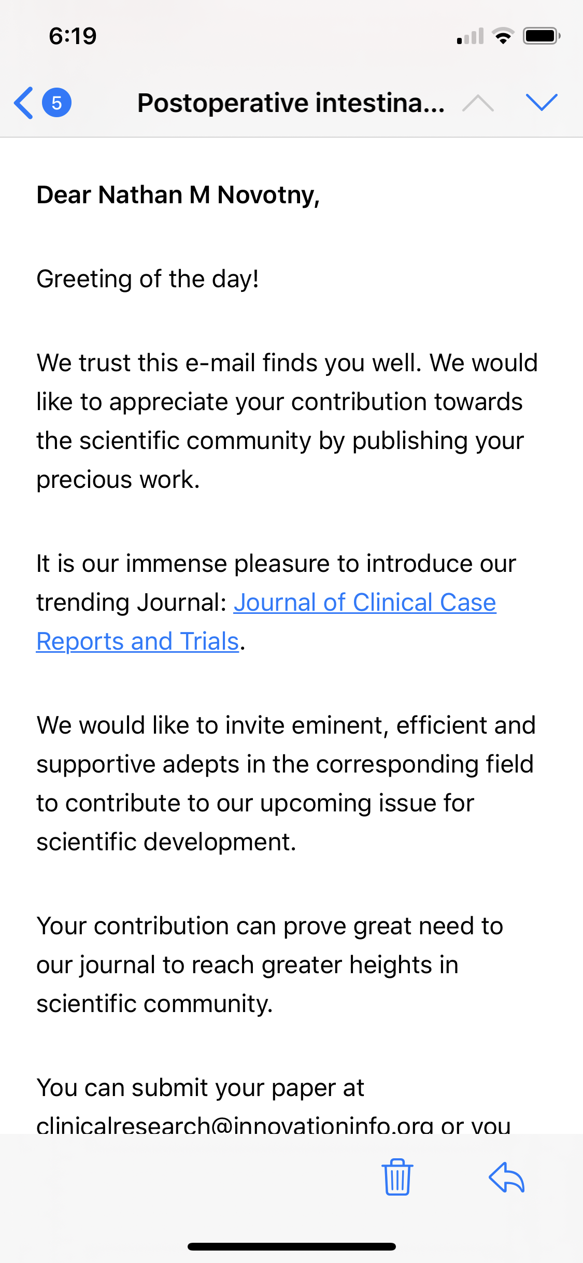
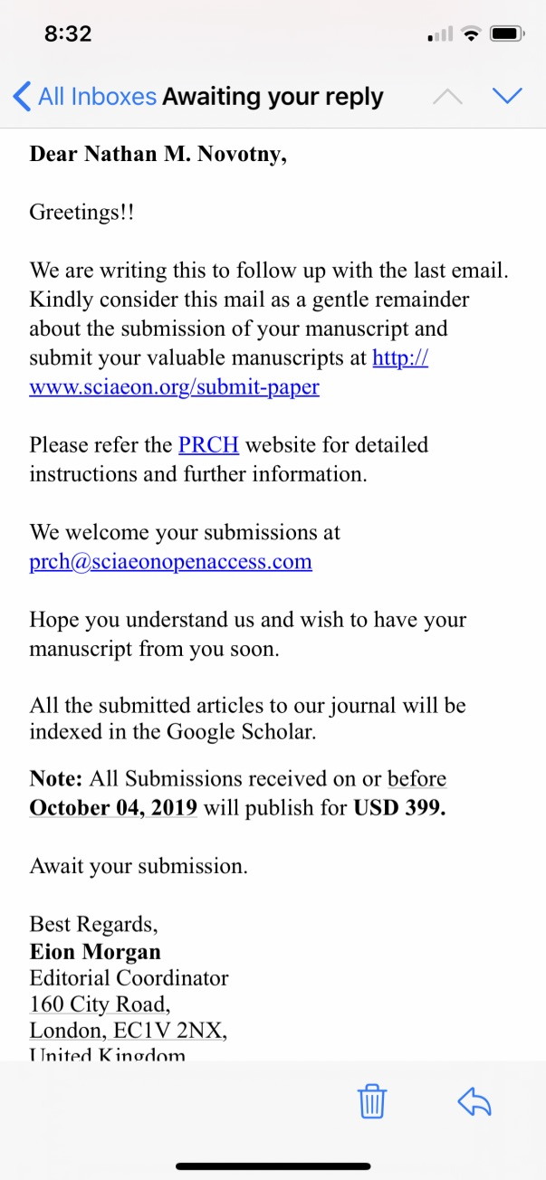
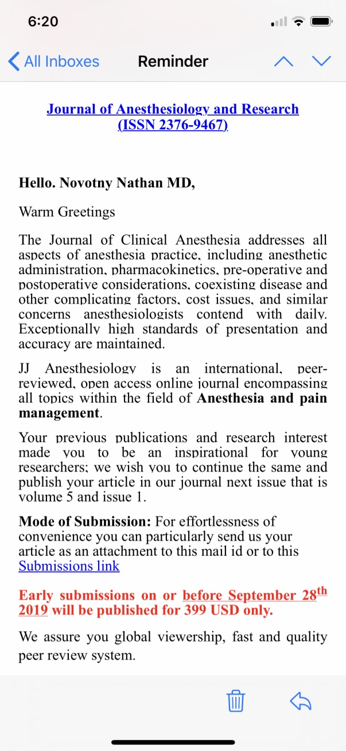
Assess the credentials of the journal or publisher

Slide 9
Assess the credentials of the journal or publisher
What are objective measures of a journal’s importance/difficulty in acceptance?
Impact factor
Quartile (SCImago link)
Your own history

Slide 10
Impact Factor
Probably the most well known
Calculated over a two year period
Simple calculation of number of times cited divided by citable articles
Manipulated

Slide 11
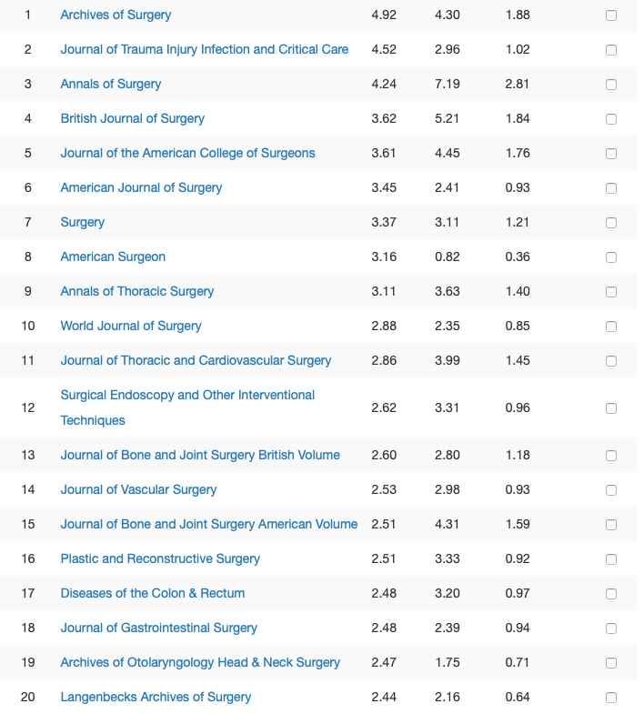
That being said...

Slide 12
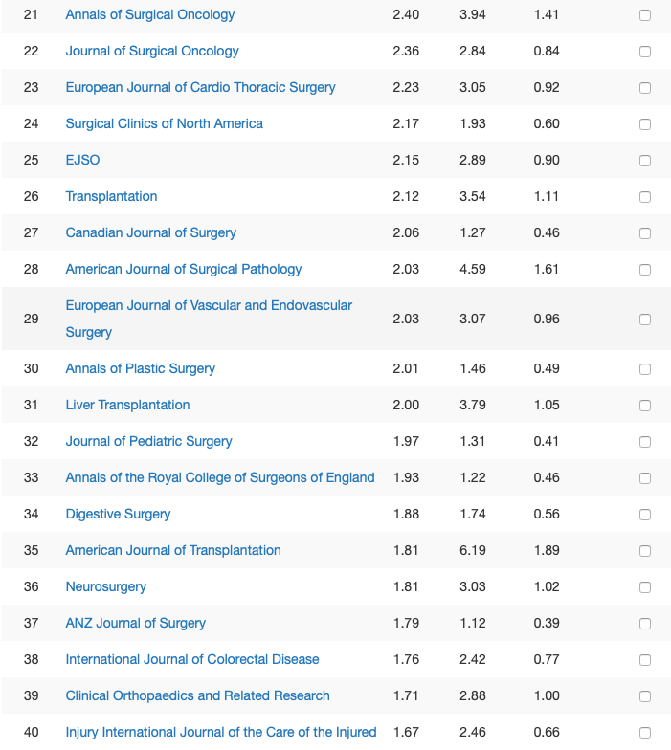

Slide 13
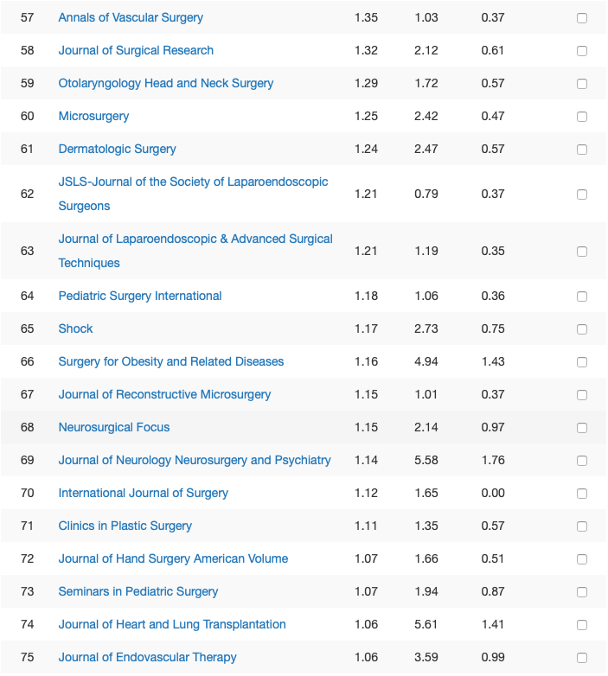

Slide 14
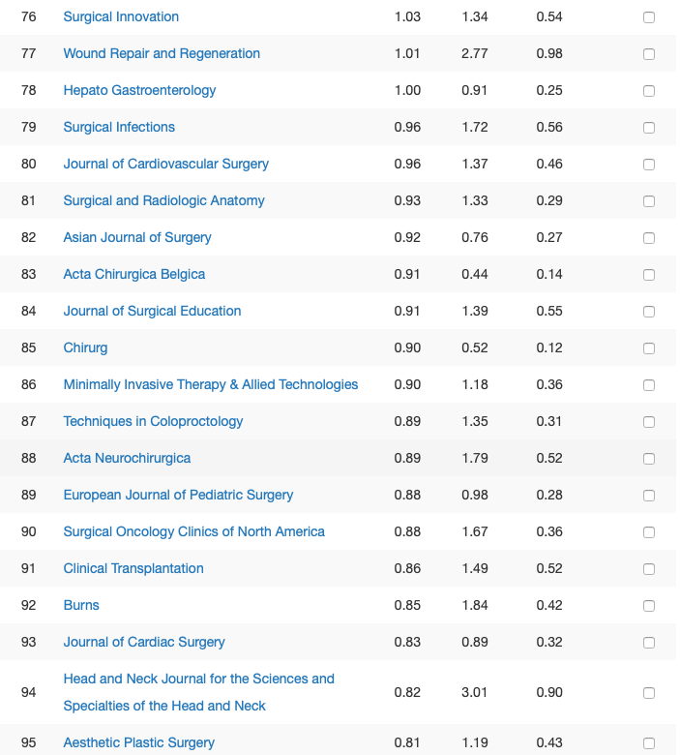
BMJ says...

Slide 15
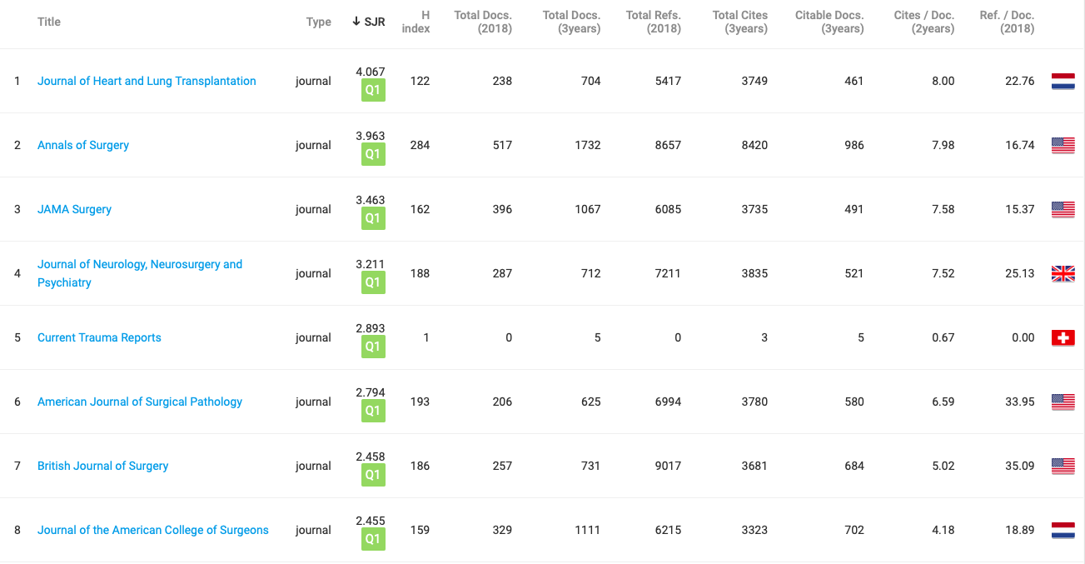
Quartile Ranking
sdflk

Slide 16
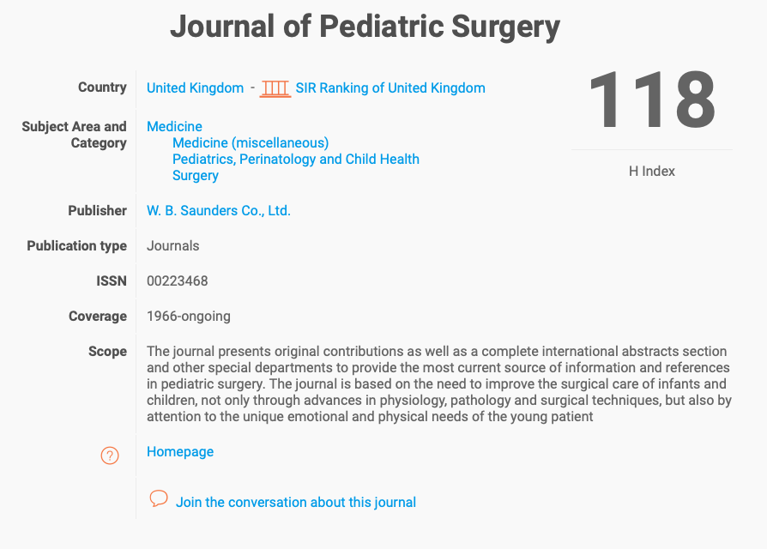
BMJ says...
asdf

Slide 17
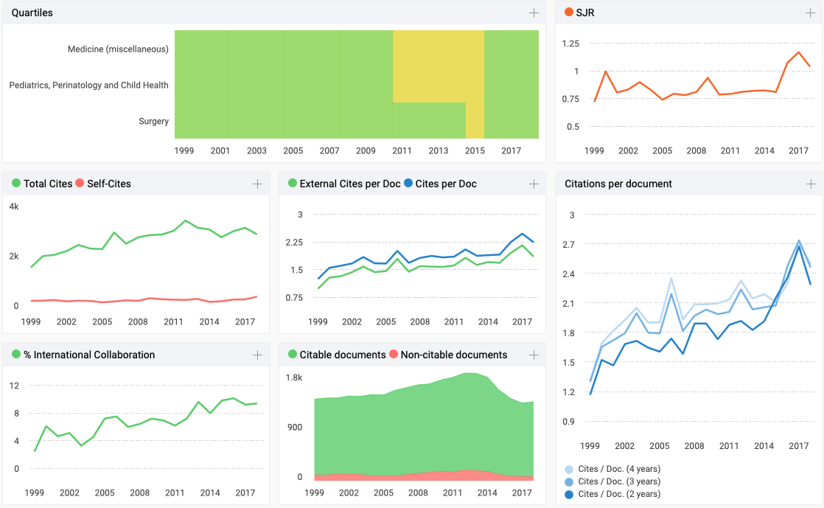
BMJ says...

Slide 18
Why look at all of this?
This isn’t a commercial for JPS
Identification of the appropriate journal for your manuscript

Slide 19
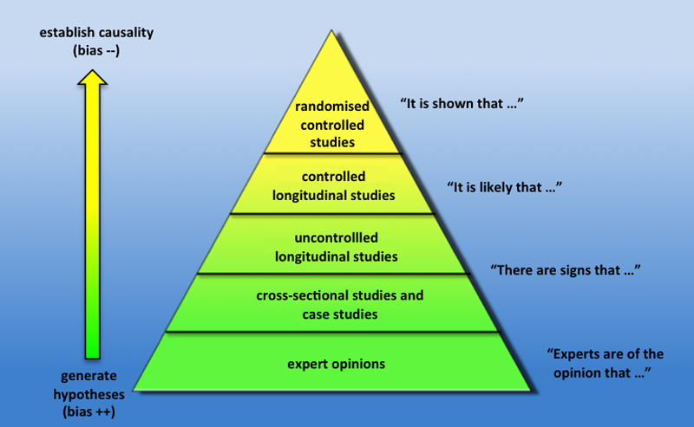
Browse the Content of the Journal and Compare to your Manuscript
Level of evidence
Your expertise in the field
Your institution’s reputation
Results
Timeliness (eg. vaping)
Size of population
Effort, overall quality, novelty

Slide 20
Check the Journal’s Website
Do they have one???
Can you easily contact the journal?
Is the publisher clearly displayed?
Would you read the articles published?
Are they clear about fees, if any?
Who is on the editorial board?*
Think Check Submit
Directory of Open Access Journals

Slide 21
Check What Services are Offered to Authors
Web-based submission vs. ‘send us your abstract via email’
Assistance in choosing the right journal (Elsevier)
Interesting but proprietary...
Review and publication speed is often published now
And more...

Slide 22
BMJ says...
asdf

Slide 23
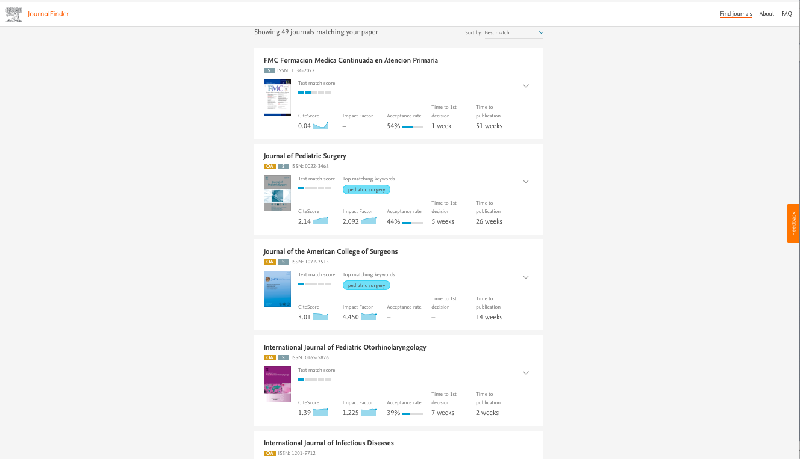
BMJ says...
asdf

Slide 24
Submit your Manuscript to One Journal at a Time

Slide 25
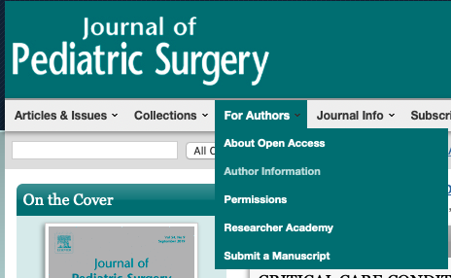
Author Instructions
Every journal has ‘em
Some are more painful than others

Slide 26
BMJ says...
asdf
Wordy, eh?

Slide 27
But, you avoid this...

Slide 28
And Finally: Conference-Associated Journals
Major national and international conferences (APSA, BAPS, PAPS, EUPSA, IPEG, WOFAPS, International Colorectal Club, and more)
Typically a higher percent-acceptance rate
Quick response
More ‘hits’ on your CV
Downside: cost of travel, conference, etc.

Slide 29
Objective Review
Understand the reason for publishing scientific works
Accurately assess your manuscript and which journal is the
best fit
Identify characteristics of journals with scientific value
Identify characteristics of journals that simply want your $$
Understand where to find and how to properly format your
publication prior to submission

Slide 30
Thank you for listening, any questions?
globalpaedsurg4@gmail.com
@GlobalPaedSurg #GlobalPaedSurg @PaedsSurgeon
www.globalpaedsurg.com

